Slide 1
Black Hole Astrophsics The Engine Paradigm Ch2.3~Ch2.6
8/8 2:00 pm

Slide 2
Ch2.3 Seyfert Galaxies and Quasi-Stellar Objects

Slide 3
2.3.1 Unification of Classical Seyfert Galaxies by Viewing Angle
Robert Antonucci and Joseph Miller proposed a important unification of all Seyfert galaxy types
Three point to prove this model

Slide 4
Seyfert unifiedmodel

Slide 5
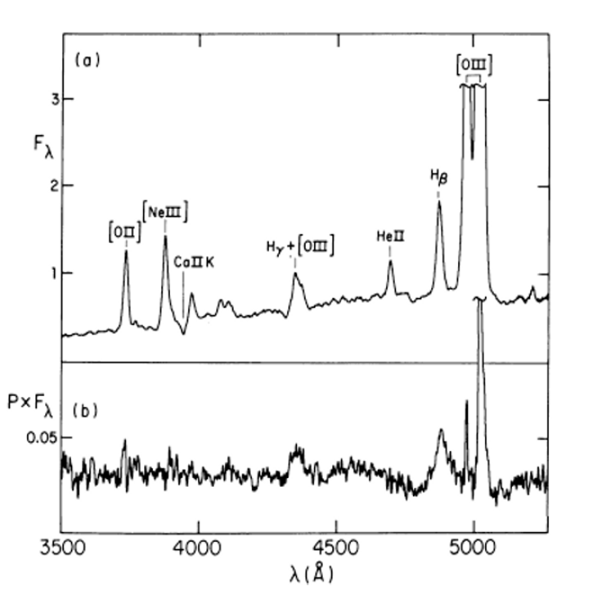
Spectrum of Seyfert 2 galaxy NGC 1068
$$H_{β} line at 4861\dot{A}$$
it’s resembles Seyfert1

Slide 6
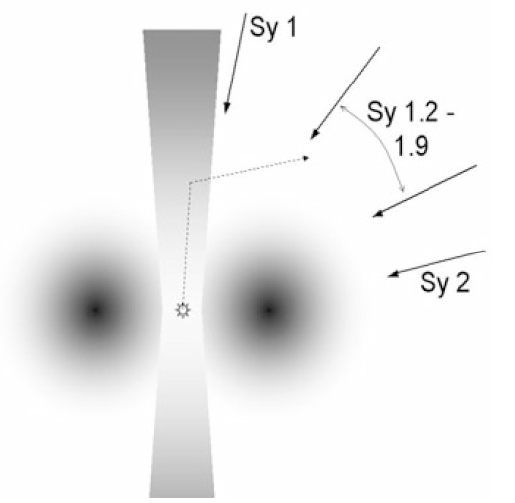
Ionization zone
Polarized light
Dashed line :
Scattered light from center

Slide 7
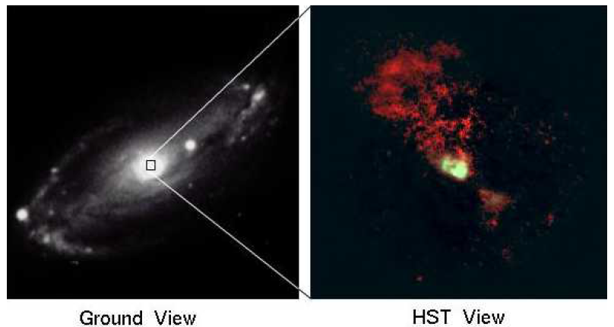
Seyfert 2 galaxy NGC 5728
This confirmed not only that the NLR was extended, but also that it was created
by ionizing radiation and was shadowed by a dusty torus everywhere except along
the torus’ axis.

Slide 8
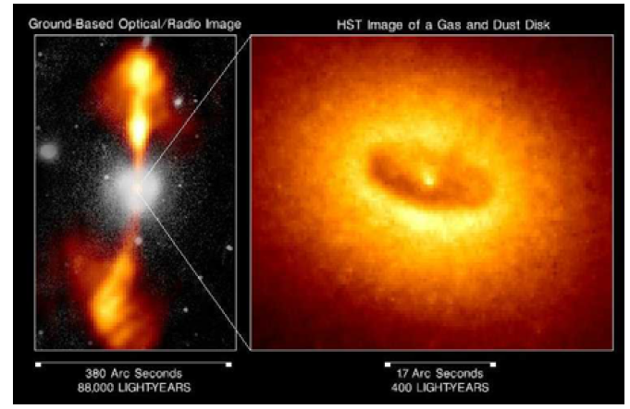
Radio galaxy NGC 4261
That confirmed this model was direct imaging (in reflection and also
by Hubble) of the dusty torus itself in objects such as NGC 4261.

Slide 9
Ch2.3.2 The X-Ray Spectrum of Seyfert Nuclei

Slide 10
Ch2.3.2.1 Comptonized Power Law,Reflection Spectrum,and Iron K$α$ Emission

Slide 11
The observed X-ray spectrum of Seyfert galaxies is rather “hard.
Spectrum is thought to be produced when photons emitted by an optically thick, cool (106.7 K) disk are Compton up-scattered by a hot, optically thin (${10}^{9}$ K) plasma.
Seyfert 1 galaxies there also appears to be a ‘reflection’ component, peaking at about 20–30 keV (50–72 × 1017 Hz), which is produced when the very hard X-rays from the power-law source strike cold gas and then are down-scattered.

Slide 12
Seyfert galaxies types 1.5–2 is considerable absorption at lower X-ray energies (a few keV) due to a large number of cold atoms along the line of sight between the observer and the X-ray emitter .
This result is consistent with the above dusty torus model.

Slide 13
Other Seyferts with broad red iron line wings indicates that rotational velocities of the disk are so high that the disk must approach extremely close to the black hole – well within the last stable orbit radius for a non-rotating black hole (6 GM/c2).

Slide 14
Continuum radiation, there is strong line emission from iron at about 6–7 keV. Iron has a Kα fluorescence line in this energy range, occurring when hard X-rays knock out an inner K shell electron, and a remaining outer shell L shell electron then falls back down to the K shell, emitting a photon as the newly-ionized atom readjusts.

Slide 15
Seyfert spectra models generally assume that the original hard power law emission is produced by a geometrically thick, hot disk region or corona near the center of an accretion disk around the black hole.

Slide 16
X-ray satellite ASCA (Advanced Satellite for Cosmology and Astrophysics) to observe the Seyfert 1 galaxy MCG-6-30-15.
They found that, while the emission line peaked at the expected 6.4 keV and had little emission above that, the line had an unusually broad red wing that extended down to below 4 keV.
This broad emission is most likely caused by the
relativistic gravitational redshift in the deep potential well of the central black hole.
Doppler redshift of the material rotating in the relativistic accretion disk around the hole.
Confirmed the iron line in Seyfert 1 galaxies is indeed formed very near the black hole in the accretion disk.

Slide 17
Ch 2.3.2.2 The Warm Absorber

Slide 18
Iron Line properties:
Product by reflection and/or reprocessing
Seyfert 2s stronger than Seyfert 1s
There is an indication that some, the observed iron Kα emission in Seyfert 2 galaxies might be produced in cold material that lies on the inner far side of the dusty torus rather than very near the black hole.

Slide 19
When viewed in Seyfert 1s from above the dusty torus, the reflection will be much less, as the Kα emission produced near the black hole will not be absorbed.
When the torus is viewed in Seyfert 2s from the side, this material is seen in reflection, while the Kα emission produced near the black hole may be attenuated or absorbed entirely.

Slide 20
Warm absorber named by Jules Halpern (At Caltech and the Smithsonian Astrophysical Observatory in Cambridge) .
Such ‘warm’ (T < ${10}^{5}$ K) absorbing gas was seen in Seyfert 1s in the mid 1980s with the Einstein X-ray observatory.

Slide 21
2.3.3 Narrow-Line Seyfert 1 Galaxies
A recent addition to the Seyfert family of galaxies are those whose nuclear spectra have the same kind of lines as those in Seyfert 1 nuclei, but their permitted lines are rather narrow (well under 2000 km s.1, compared to several thousand km s.1 for normal Seyfert 1s).

Slide 22
They are a separate class, distinguished by their unusually soft X-ray emission, peaking around 0.2 keV (5 × ${10}^{16}$ Hz), making them more like extreme ultraviolet sources than X-ray sources.
One interpretation of this new class is that these narrow-line Seyfert 1 galaxies (NLSy1s) are in a high-luminosity “soft” Xray state, similar to the soft state of binary X-ray sources (see Ch 3).

Slide 23
Classical X-ray hard Seyfert galaxies, then, would be black holes in a lower-luminosity hard accretion state.
Seyfert nuclei to undergo transitions between the intermediate and high/soft states, just as we see in the lower-mass black holes in binary star systems.
That is, we might expect to see
Hard X-ray Seyfert 1 galaxies
NLSy1s
Latter
we often see such state changes occur over a half-hour for a 10 solar mass
NLSy1s
classical Seyfert 1s

Slide 24
Ch 2.3.4 Quasi-Stellar Objects

Slide 25
2.3.4.1 BSOs and Type 1 QSOs: More Unification by Brightness Contrast
BSO(blue steller object) : Images of regions of the sky were taken in different color filters, and stellar objects with colors bluer than normal stars were selected from those images. (A blue color indicated that the “star” likely had strong ultraviolet emission, just like most radio QSRs.)
Many of these “blue stellar objects” or BSOs turned out to be indeed identical to QSRs optically, but most had no detectable extended radio emission.
Depending on redshift, the BSOs had strong, broad optical and ultraviolet emission lines at the frequencies of (redshifted) hydrogen Balmer β …etc

Slide 26
2.3.4.2 Type 2 QSOs, LIRGs, ULIRGs, HyLIRGs, and SMGs
Type 2 QSOs:
There were no Type 2 QSOs known in observation. Only Type 1 objects was known
Two explanations for it
Any Seyfert nucleus bright enough to be a QSO also was bright enough to evaporate the dust and ionize. the gas in any torus around it.
Type 2 QSOs do exist, and they are some of the famous objects discovered by the InfraRed Astronomy Satellite (IRAS) in the 1980s called Luminous InfraRed Galaxies or LIRGs.

Slide 27
LIRGs are galaxies that are enormously bright in the infrared, with luminosities above ${10}^{11}$ Solar Luminositiy
LIRGs are the most abundant species, exceeding the numbers of Seyferts and QSOs that have similar power output
The term Ultra-Luminous InfraRed Galaxy (ULIRG) refers to even more luminous infrared galaxies with output above ${10}^{12}$ Solar Luminositiy.

Slide 28
Hyper-Luminous InfraRed Galaxy (HyLIRG) refers to those rare objects above ${10}^{13}$ Solar Luminositiy
SMGs are ULIRGs at high redshift, but their space density at those redshifts is far higher than the space density of ULIRGs today by a factor of several hundred, similar to that of the Lyman break galaxies that are seen at optical wavelengths.

Slide 29
2.3.4.3 Type 3 QSOs?
QSOs whose high-ionization optical emission is hidden from view, no matter from which direction they are observed, be placed in a new class called Type 3 AGN.

Slide 30
2.3.4.4 Radio-Loud and Radio-Quiet QSOs: The Radio Loudness Ratio
Most supermassive accreting black hole systems, it seems, do not produce a powerful jet. This fact can be made quantitative if we calculate for each QSO a ratio R of radio to optical emission
$$R=\frac{S_{r}}{S_{o}}$$
where Sr and So are the radio and optical flux densities of the
quasar both measured in janskys.

Slide 31
Radio-loud quasars (RLQs or just QSRs) are defined as R > 100
Radio-quiet quasars(RQQ) are defined as R < 100
This definition works well when we consider only the low-frequency extended radio emission below 1 GHz.
At frequencies above 5 GHz, the effects of beaming can be significant, so the R value will appear different for an object viewed from one direction than from another.

Slide 32
Figure shows the R distribution function for QSOs. Early in the study of QSOs, it was claimed that the R distribution function may be “bimodal”, with a peak in the radio-quiet region and a peak in the radio-loud region.
One determination of the R distribution with no bimodality, although it does show a long tail at high R.(left-hand)
Right hand figure shows that R may be bimodal, although not nearly at the level that was originally thought.

Slide 33
2.3.4.5 Host Galaxies of QSOs
In 1994–96 when John Hutchings’ team and another team led by John Bahcall, of the Institute for Advanced Study, alternately submitted papers that presented detailed images of galaxies around QSOs, including some at high redshift .
The clarity and resolution of the HST observations convinced most skeptics that quasars are indeed AGN.
Host galaxies of RLQs tend to be very bright (similar in magnitude to giant ellipticals)
Hosts of RQQs tend to be 0.5–1 magnitude fainter (more typical of giant spirals)

Slide 34
2.3.4.6 BAL QSOs: Yet More Unification by Viewing Angle?
BAL QSOs is The Broad Absorption Line
The broad absorption line is detached from the emission line – several thousand km/s wide, with 10,000 km/s or more separating the two. (See Fig. 2.16 and Fig. 2.17.)
Generally these absorption lines are from high-ionization atomic species (C IV, Si IV, N V, O VI) only; these are called HiBALs.
In about 10% of the BAL cases (1% of QSOs), low-ionization lines of Mg II or Al III also appear, and these are referred to as LoBALs.

Slide 35
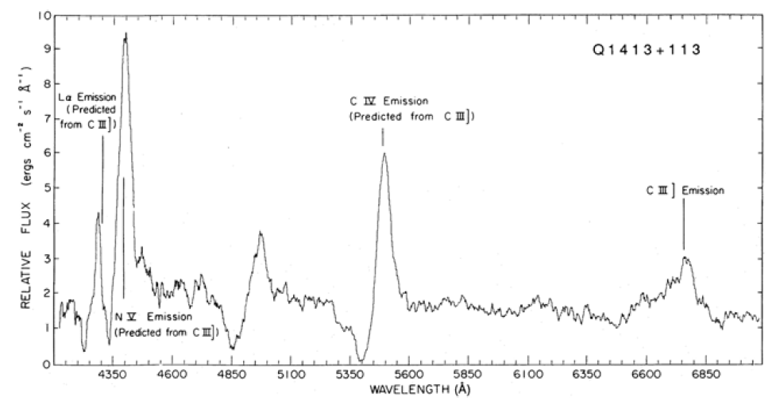
Typical spectrum of a BAL QSO with “attached” absorption troughs and the
standard BAL QSO model. Top: Note outflow in Q1413+113 at up to 12,000 km/s

Slide 36
The standard model for BAL QSOs James Chiang, and their colleagues at the Canadian Institute for Theoretical Astrophysics (CITA) in Toronto) is that these objects are normal QSOs that are viewed nearly edge-on to the accretion disk that is feeding the black hole (see Fig ) .
An outflowing wind ablates matter off the disk forming the absorption line clouds.

Slide 37
This model has a number of attractive features.
Analysis of the absorption lines indicates that the absorbing gas surrounds only about one-fifth of the central QSO – a covering factor of 0.20.
This means that there must be five times as many QSOs with such winds (or 0.50% of all QSOs) in which we will not see absorption lines.
So half, and maybe all, QSOs may have strong winds, but we only observe as BALs those with their disks edge-on.

Slide 38
Detailed numerical simulation of disk winds driven by radiation pressure from their surface by Daniel Proga and his colleagues shows that this model can, indeed, produce the right sort of wind, including the generation of “hitchhiking gas” needed to shield the absorbing clouds from the central X-ray emitting region.
The radiatively-driven disk wind model does have some problems explaining many BAL QSO properties.

Slide 39
An alternative, but less popular, model involves a bipolar magnetohydrodynamically-driven wind model (Fig. 2.17).
A bipolar wind model has most of the attractive features of the disk wind model, is more consistent with modern accretion models and simulations, and explains the radio-loud/BAL avoidance: QSRs with very powerful jets are likely to have much narrower bipolar winds and, therefore, a much lower incidence of BAL detections.

Slide 40
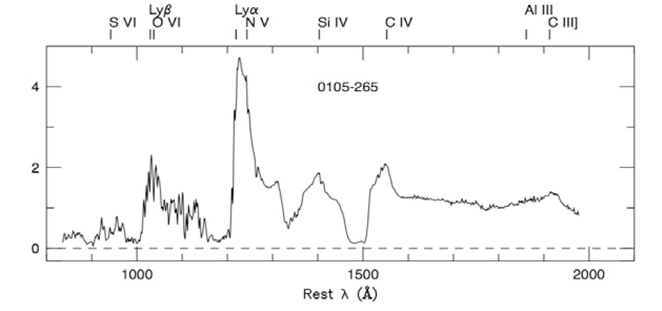
A detached trough BAL QSO.
Such objects would appear as LoBALs when viewed with the lower-ionization wind material (Al III, Mg II, Fe II) obscuring the central source, as HiBALs when viewed through the higher-ionization wind material (C IV, S IV, N V), and as a normal QSR when viewed at a large angle from the jet axis.

Slide 41
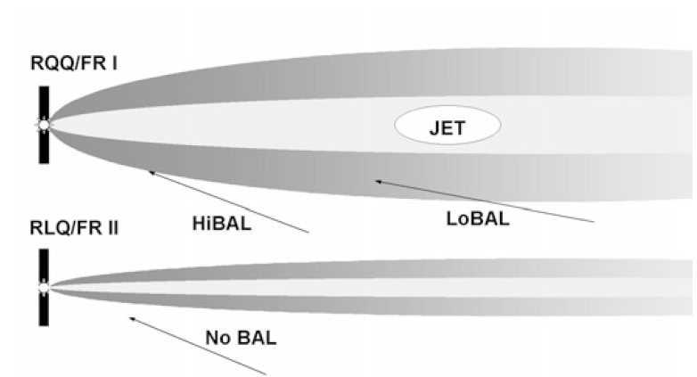
A bipolar MHD wind model with RQQ/FR I and RLQ/FR II structures.
The probability of viewing a strong FR II jet through the optically obscuring material would be very small, if any such thermal material even existed in a powerful FR II jet.

Slide 42
2.3.4.7 The X-Ray Spectrum of Radio-Quiet QSOs
Radio-quiet QSOs is dominated by the disk emission, just as it is in the related Seyfert 1 objects.
The basic X-ray spectrum is similar -$f_{υX}∝ υ^{−1}$
power law above about 1 keV, with a high-energy cutoff . but the reflection components (20.30 keV bump and iron line) appear to be greatly diminished or absent.

Slide 43
2.3.5 Cosmic Evolution of Seyferts and QSOs
Maarten Schmidt’s 1972 studies on quasar evolution also investigated the optically selected QSO population.
Its evolution appeared similar to that of the radio-selected population in equation (2.10) (essentially pure density evolution with a time constant of about 2.7 Gyr).
$$ρ\left(z\right)=ρ_{o}\frac{[τ_{o}−t(z)]}{τ}$$
This question may be resolved by deriving the time-dependence of the X-ray luminosity function from the X-ray background.
But, until it is, the cosmological evolution of the Seyfert population will remain an important missing constraint on models for grand unification of all macroquasars.

Slide 44
2.4 Low-Luminosity Active Galactic Nuclei (LLAGN)
Low-luminosity AGN (or LLAGN) : the fainter they looked, the more active galactic nuclei they found.
Observed by amateur astronomers,
M81, M84, M104,NGC4528 and the nucleus of our own Galaxy are the LLAGN.

Slide 45
2.4.1 Dwarf Seyferts, LINERs, Transition-type, and H II Nuclei
The brighter of these objects (i.e., with luminosities of ${10}^{41−42}$ erg/s) are classified as dwarf Seyfert galaxies.
If there is some star formation in the nucleus, the ultraviolet light from new hot O and B stars can ionize the surrounding gas to a low state, just as in H II regions like the Orion nebula. (This problem of distinguishing between AGN and starburst is reminiscent of the LIRG → HyLIRG sequence, but now at the low-luminosity end of the active galaxy spectrum instead of the high end.)

Slide 46
Objects in which it is clear that both star formation and a weak AGN are operating are called transition-type nuclei.

Slide 47
2.4.2 Radio Cores
Most LLAGN, including our own Galactic nucleus, have some detectable radio emission.
Such objects are often referred to as radio cores.

Slide 48
2.4.3 Weak-Lined Radio Galaxies
The optical luminosity of these weak-lined radio galaxies (or WLRGs) lies below those of N-galaxies in the same way as LINERs lie below Seyferts.
The optical properties of WLRGs are quite similar to those of LINERs, so the former may be the radio-loud counterpart to the latter.
As do all radio-loud galaxies, WLRGs occur exclusively in giant elliptical or S0 galaxies – ones with a large spheroidal bulge of stars.

Slide 49
2.4.4 Sgr A*: The Quiescent Black Hole Engine at the Center of Our Galaxy
The central black hole is often referred to as Sgr A* which is LLAGN standards.
If one were to travel to the Galactic center, about 100 pc from the black hole one would encounter a system of dense molecular clouds.
Embedded within this cloud system is the “nuclear star cluster”, several tens of parsecs in radius.

Slide 50
This star system is composed of cool, middle-aged; bright horizontal branch and red supergiant stars would be very prominent.
The stellar density of this system increases inward toward the black hole similar to an isothermal sphere distribution (ρ ∝ $r^{−2}$).
At a distance of only a few (1.5–4) parsecs from the black hole lie cool, dense molecular cloud streamers (the “circum-nuclear disk” or CND) orbiting the central regions.

Slide 51
Inside the central parsec (which turns out to be approximately the black hole sphere of influence $r_{h}$) the gas is ionized to T . ${10}^{6}$ K, creating a low-density “central cavity”.
The cavity also has a set of cooler (${10}^{4}$ K) gas filaments (the “minispiral”) that orbit the central object.
deep inside that, at a distance of only .0.03–0.1 pc from the hole, lies at least one disk of O/B and Wolf–Rayet stars orbiting that central object in the opposite sense to the Galactic rotation.

Slide 52
Furthermore, in the central 1/30 pc (7000AU) of this disk lies a more spherized and randomized distribution of many tens of young B stars. It is these stars that are used to determine the central black hole’s mass (see Fig. 1.1).
Models for the accreting plasma near the black hole
The accretion rate is $\dot{m}=\frac{\dot{M}}{{\dot{M}}_{Edd}} \sim {10}^{−5}$
which would produce $\frac{L}{L_{EDD}} \sim {10}^{−9}$

Slide 53
As we approach the hole, then, the electron temperature of the RIAF gas rises to ${10}^{9}$K about 1000 $r_{g}$ out (4000 AU) and then saturates.
The ion temperature, however, continues to rise to ${10}^{9}$ K just outside the hole and right before the plasma enters the horizon.
RIAFs are well known for their ability to drive jet outflows, particularly when the accretion is driven by magnetic turbulence.
Therefore, a hybrid RIAF-jet model is probably the most likely description of the immediate environs of Sgr A*.

Slide 54
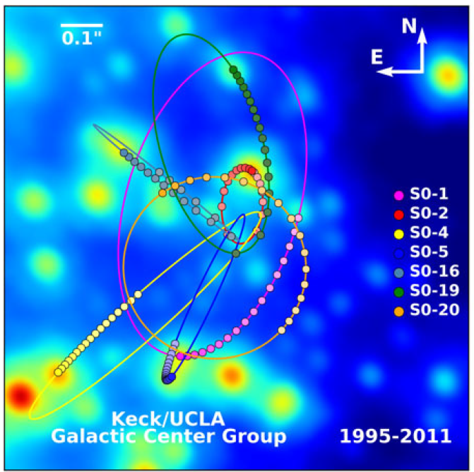

Slide 55
2.5 “Inactive” Galactic Nuclei
the presence of a black hole and its mass can be inferred simply by measuring the velocities of the central stars in a galactic nucleus.
$σ_{v}=k{(GM_{∙}^{}/r)}^{\frac{1}{2}}$a black hole of ${10}^{9}$M in a galaxy 10–100 Mpc away would produce stellar velocities of order several hundred kilometers per second within a fraction of an arcsecond of the observed galactic center.

Slide 56
These studies produced a surprising and important result: black holes in weakly active or inactive galaxies are every bit as massive as those inferred to be powering the mighty quasars .
Their inactivity must be due not to the lack of a large central engine, but simply to the current lack of fuel being fed to that engine.

Slide 57
2.5.1 The$M_{\text{‧}}$–$M_{bulge}$ Relation
It appears that the black hole mass in any galaxy depends primarily on the properties of the spheroidal bulge of stars in that galaxy. (See Fig. 2.18.)
And giant spiral galaxies with small bulges have similar mass black holes to those in bare dwarf ellipticals with similar small-mass bulges but no spiral disk .
Bulges of higher mass have more massive black holes with an approximate linear relation
$$M_{\text{‧}}≈0.0013M_{bulge}−−−2.12$$
Magorrian relation is discoverer a $M_{\text{‧}}$–$M_{bulge}$ correlation

Slide 58
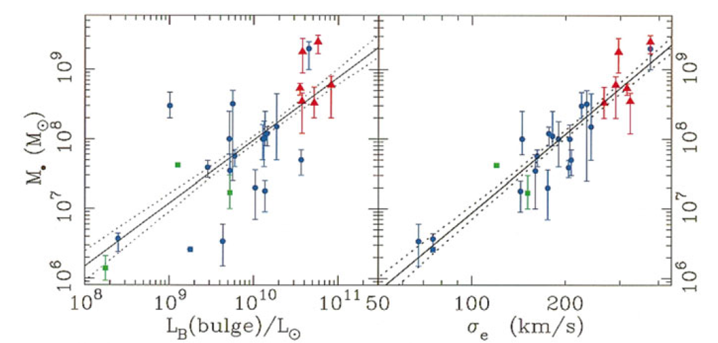
From known mass–luminosity relations for elliptical galaxies
$M_{bulge}=1.9×{10}^{10} {(\frac{L_{bulge}}{L_{⨀}})}^{1.25}$ ----2.13
The black hole mass vs. bulge luminosity (left) and velocity dispersion (right) relations. The considerable scatter in the M•–Lbulge relation indicates that more than just galaxy bulge mass may influence black hole formation. The M•–σbulge relation (often called the “M–σ” relation) is considered much tighter, as it has scatter consistent with the vertical error bars

Slide 59
2.5.2 The $M_{\text{‧}}$–$σ_{v}$ Relation
The black hole mass correlates even better with the velocity dispersion of the starsin the outer part of the bulge (right panel of Fig. 2.18)
$$M_{\text{‧}}=1.3×{10}^{8}M_{⨀} {(\frac{σ_{bulge}}{200km/s}) }^{4.0}$$
σbulge is harder to measure than Lbulge.
the easiest way to estimate a black hole mass in the center of a galaxy is
measure the bulge luminosity and use equations (2.12) and (2.13)
measure the velocity dispersion of the stars in the bulge and use equation (2.14)
measure the velocity dispersion of the stars very near the black hole and use equation
measure the velocity structure of the broad line clouds surrounding the black hole using reverberation mapping

Slide 60
2.5.3 The $M_{\text{‧}}$–$r_{core}$ Relation
In 1999 Roeland van der Marel, of the Space Telescope Science Institute studied how the properties of these core galaxies and their black holes correlate and found a relation between the mass of their galaxy cores and the masses of their black holes ($M_{\text{‧}}∝{M_{core}}^{\frac{1}{2}}$)
The slope black hole mass–core radius relation is that the overall fit gives a relation
$$logr_{c}=0.52logM_{\text{‧}}−2.06$$
with $r_{c}$ in parsecs and $M_{\text{‧}}$ in solar masses. This is close to the relation
$$r_{c}=422pc{(\frac{M_{\text{‧}}}{{10}^{9}M_{⨀}})}^{\frac{1}{2}}$$

Slide 61
Implies a core mass–black hole mass relation of
$M_{core}≈7M_{\text{‧}}≈0.009M_{\text{bulge}}$
So they are approximately proportional to each other
$M_{\text{‧}}∝$ $M_{core}$

Slide 62
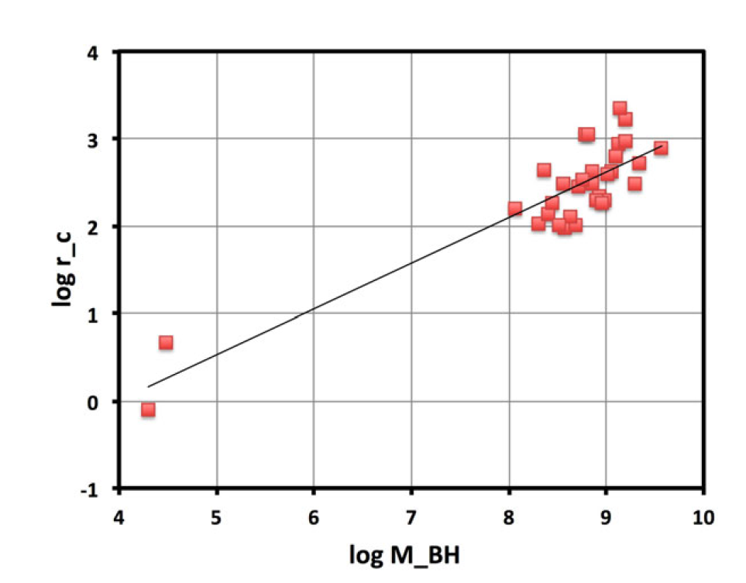
Data from the literature for core galaxies on the variation of core radius with black hole mass.

Slide 63
2.6 Macroquasars – A Summary and Synthesis
Black hole masses are the same for all galaxies with similar bulges is perhaps the most important result.
The fact that one galaxy of a given type can have a bright QSO in its center, while another will appear normal, must be largely statistical or perhaps environmental.
Some recent event that is probably independent of the central nuclei of both galaxies has triggered the activity in one and not the other.
The currently quiet galaxy may become active while the active one may become dormant.

Slide 64
A second important conclusion comes from the comparison of host galaxies of the brightest QSOs and the optically similar, but fainter, Type 1 Seyfert nuclei.
The brightest QSOs occur in galaxies with the largest spheroidal bulges, while Seyferts occur in galaxies (spirals) with smaller bulges.
The brightest QSOs occur in galaxies with the largest spheroidal bulges, while Seyferts occur in galaxies (spirals) with smaller bulges.
Their large difference in luminosity is by their fueling rate(mass) and their difference in black hole mass: more massive black holes simply are larger engines and can produce more power.
Their luminosities are within a factor of 10 of the Eddington maximum limit for their black holes

Slide 65
The third important conclusion comes from a study of the host galaxies of radio-loud and radio-quiet QSOs.
They found that the brightest QSRs and QSOs both occur exclusively in giant elliptical galaxies .
A bright QSR and a bright QSO must, have similar black hole masses, host galaxies, and fueling rates.
They differ in their ability to produce a powerful, extended radio jet by a factor of 10,000!
A difference cannot be due to beaming, because even an unbeamed jet would produce a strong extended radio source.
Such a difference cannot be due to beaming, because even an unbeamed jet would produce a strong extended radio source.
Clearly, there must be another property of the central black hole system that determines whether or not a jet can be produced and yet does not affect the black hole’s ability to produce optical emission.

Slide 66
While it is clear that a third parameter is needed to control the jet power, it still is the case that fueling rate and black hole mass play an important part.
The most rapidly-fueled objects (QSRs) have the most powerful FR II jets.
$L_{jet} ∝M_{\text{‧}}$
More massive black holes are more efficient at producing strong radio jets.
More massive black holes are more efficient at producing strong radio jets. This is undoubtedly related to why radio galaxies and QSRs occur exclusively in elliptical galaxies with very massive black holes.
Notes:
This is undoubtedly related to why radio galaxies and QSRs occur exclusively in elliptical galaxies with very massive black holes.

Slide 67
Dunlop and McLure’s work nevertheless supports unification of QSRs and FR II radio galaxies by orientation. Their host galaxies and their radio jets appear to be very similar.
And in some cases, FR II radio galaxies are found to have a hidden broad line quasar in reflected polarized light.
FR II radio galaxies, therefore, are probably QSRs whose accreting black hole is hidden by a dusty torus.
Two different approaches are shown in Fig. 2.20
A supermassive black hole lies at the center of the source, with an accretion disk surrounding it that produces the big blue bump and perhaps the broad line clouds as well.
An obscuring dusty torus surrounds this central source, with the narrow line region and jet lying roughly along the torus’ rotation axis.
Seyferts and QSOs can be unified similarly, but without a powerful jet in the picture.

Slide 68
This is essentially the Antonucci and Miller picture extended to radio-loud sources as well.
The second approach (right panel in Fig. 2.20), by Todd Boroson of NOAO, is based mainly on observations and their straightforward analysis and classifies objects on the basis of their black hole mass, accretion rate (inferred from the object luminosity), and “Eddington ratio” (from luminosity and mass)
$$l_{rad}=\frac{L_{rad}}{L_{Edd}}$$
The figure shows that, while RLQs tend to have larger black hole mass than RQQs, they both tend to have similar absolute accretion rates, suggesting that radio-loud objects accrete at normalized rates somewhat below the Eddington limit.
BAL QSOs have high Eddington ratios and masses nearly as large as some RLQs. NLSy1s also lie near the Eddington limit, while lower-luminosity Seyfert nuclei would lie just to the right and above the NLSy1s (at the low-mass end of the RQQs).

Slide 69
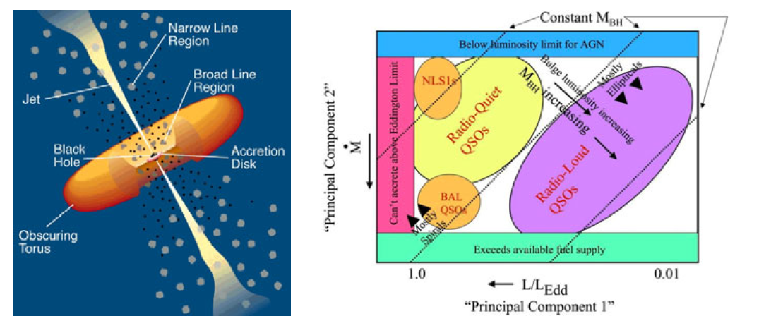
Left: Phenomenological model for an active galactic nucleus.
Right: Diagram for macroquasars in the accretion rate.Eddington ratio plane .

